Slide 1
Engineering E. coli for high level ethanol production
Neha Munjal
Research Scholar
Dr. Syed Shams Yazdani
Synthetic Biology & Biofuels Group
ICGEB, New Delhi.

Slide 2
Ethanol as BioFuel
Huge demand…less reservoir of fuel…. Search for alternative source of energy….
Ethanol one of the best candidates so far possible
As good as 15% can be mixed with petrol and can be used in most modern engines
Adds to octane rating of petrol..it contains an O₂ molecule, completes combustion
It’s a much cleaner fuel than petrol; less emission of harmful exhaust such as CO, NO₂, SO₂, hydrocarbons
In USA & Brazil, Ethanol from Corn & Sugarcane Food Vs Fuel
Focus on non-food part i.e. cellulosic production of ethanol

Slide 3
Strategies
Traditionally ethanol was produced from anaerobic fermentation of sugarcane by yeast
Various ethanologenic microbes Saccharomyces cerevisiae, Zymomonas mobilis are known
However none of the above can utilise pentose sugars (major component of lignocellulose biomass) for their growth or fermentation
One of the strategy was to express the key enzymes, of the above microbes, like Pyruvate decarboxylase & Alcohol dehydrogenase in E.coli
But introduction of foreign genes requires the containment of the biocatalysts during large fermentation and also gives stress to the organism.
E. coli has an inherent ability to produce ethanol from both hexose and pentose..Thus, manipulating its own native pathway for higher ethanol can be worth trying.
E. coli is one such organism that can metabolise both hexose & pentose sugars

Slide 4
0.5 Glucose
0.6 Xylose
Glucose to ethanol conversion in E. coli
NADH
Phosphoenolpyruvate
CO₂ + NADH
PYK (pykF)
ATP
Lactate
LDHA (ldhA)
FRD (frdABCD)
Succinate
Pyruvate
Fumarate
NADH
NADH/H₂
PDH
(aceEF-lpd)
PFL
(pflB)
Formate
CO₂ + H₂
NADH
+CO₂
Acetyl-Coenzyme-A
NADH
ADH
(adhE)
PTA
(pta)
ADH
(adhE)
ACK (ackA)
Ethanol
Acetaldehyde
Acetyl-phosphate
Acetate
NADH
ATP

Slide 5
To replace the promoter of pyruvate dehydrogenase (PDH) gene with promoters of the gene expressed under anaerobic conditions.
Functional characterization of the E. coli strain with the engineered (PDH) promoter by monitoring PDH expression levels.
Chromosomal deletion of ldhA, frdA, ackA and pflB genes for minimizing by product formation.
Functional characterization of the final engineered strain and development of fermentation strategies for high ethanol production.

Slide 6
Promoter selection
Out of the many promoters known for the genes expressed under anaerobic conditions, following 5 were selected for replacement:
 | Gene symbol | Gene name | Function
1) | adhE | Alocohol dehydogenase | facilitate the interconversion between alcohols and aldehydes or ketones with the reduction of NAD⁺ to NADH
2) | PflB | Pyruvate formate lyase | reversible conversion of pyruvate and coenzyme-A into formate and acetyl-CoA
3) | gapA | Glyceraldehyde phosphate dehydrogenase | Catalyses the conversion of Glyceraldehyde 3-phosphate to D-glycerate 1,3-bisphosphate
4) | frdA | Fumarate reductase | Fumarate + NAD⁺ succinate + NADH + H⁺
5) | ldhA | Lactate dehydrogenase | Converts pyruvate to D-lactate in limited oxygen supply

Slide 7
Replacement of PDH promoter (Datsenko Method)
E. coli B
X
PCR product

Slide 8
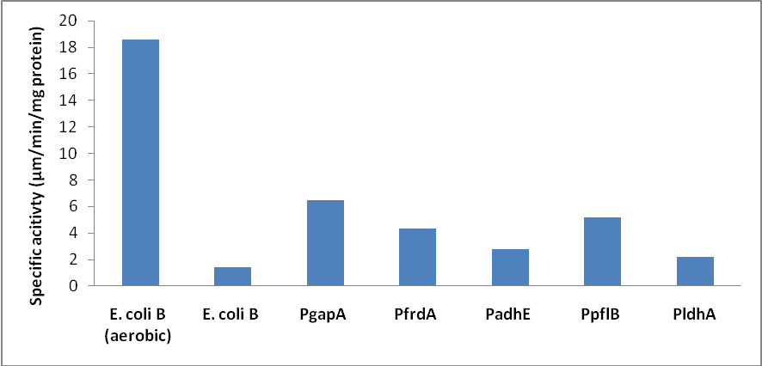
Enzyme activity of the replaced promoters , along with E. coli B grown aerobically as the positive control.

Slide 9
Real Time PCR
E. coli B and PgapA PDH RNA was reverse transcribed
aceE, aceF and lpdA regions were used for validation
dnaA gene was taken as the internal control for normalisation and
analysis was done by the Pfaffl method
Fold change of PgapA PDH with respect to E. coli B:

Slide 10
Product profile
Strains were grown in completely defined media (MOPS + other micro & macronutrients) with 2.5g/L glucose (24h), xylose (96h), galactose (48h) and arabinose (48h) as the only carbon source in fully filled hungate tubes (18ml).
Samples were run on the HPLC column, 4mM H₂SO₄, 0.3ml flow rate, RI detection.

Slide 11
Summary

Slide 12
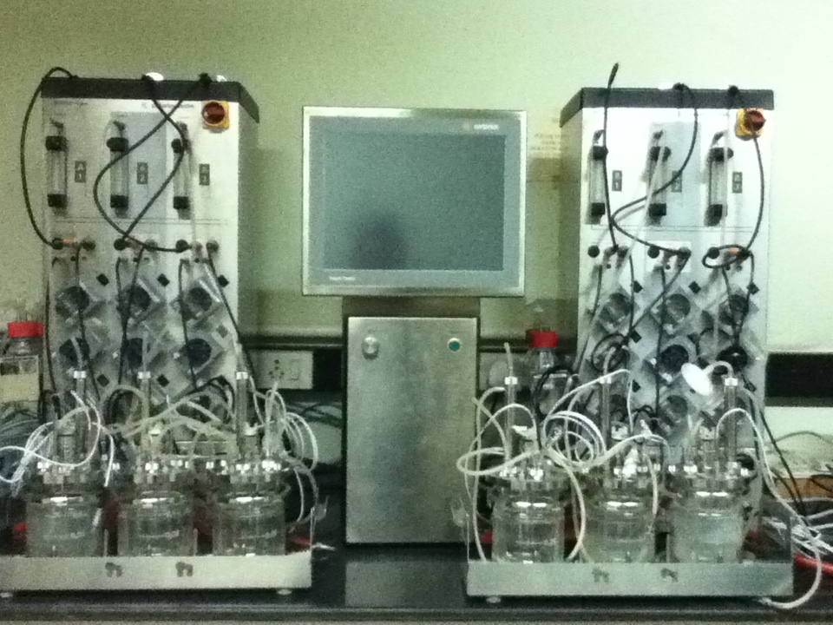
Multi vessel fermentor
Reactor working volume: 350ml
pH 6.8, argon gas, 37°C
Stirrer: 300rpm

Slide 13
1X MOPS, 18g/l Glucose, pH 6.8, 36hr profile
 | OD 600nm | Glucose comsumed (mM) | Succinate (mM) | Lactate (mM) | Formate (mM) | Acetate (mM) | Ethanol (mM) | % improvement
E. Coli B | 1.28 | 78.80 | 18.97 | 38.98 | 0.23 | 57.97 | 64.34 | -
Pldh-PDH | 1.18 | 74.72 | 7.85 | 39.47 | 1.77 | 56.53 | 57.68 | -10.48
Pgap-PDH | 1.59 | 78.38 | 17.45 | 14.73 | 0.29 | 51.20 | 91.89 | 42.82
Pfrd-PDH | 1.67 | 84.43 | 13.99 | 27.36 | 2.31 | 113.11 | 58.71 | -8.70
Padh-PDH | 1.33 | 79.29 | 18.55 | 33.99 | 0.33 | 51.45 | 75.37 | 17.14
Ppfl-PDH | 1.93 | 94.54 | 28.92 | 41.54 | 0.29 | 61.78 | 73.26 | 13.87

Slide 14
1X MOPS, 18g/l Xylose, pH 6.8, 84hr profile
 | OD 600nm | Xylose comsumed (mM) | Succinate (mM) | Lactate (mM) | Formate (mM) | Acetate (mM) | Ethanol (mM) | % improvement
E. Coli B | 1.35 | 80.29 | 11.11 | 1.12 | 34.54 | 78.12 | 54.41 | -
Pldh-PDH | 1.12 | 104.44 | 5.13 | 15.00 | 12.84 | 53.90 | 44.48 | -18.25
Pgap-PDH | 1.73 | 113.18 | 12.50 | 0.00 | 68.97 | 47.01 | 100.13 | 84.03
Pfrd-PDH | 1.20 | 49.70 | 4.97 | 1.90 | 92.31 | 65.85 | 52.71 | -3.11
Padh-PDH | 1.45 | 84.36 | 25.30 | 0.50 | 68.96 | 41.59 | 64.44 | 18.44
Ppfl-PDH | 1.97 | 97.19 | 4.76 | 29.29 | 43.84 | 50.30 | 73.97 | 35.95

Slide 15
E. coli B Vs PgapA PDH end products under fermentative conditions
Ethanol Productivity
Maximum = 0.064 g/l/h
Average = 0.036 g/l/h
Ethanol Yield = 0.18 g/g
Products (g/l)
Ethanol Productivity
Maximum = 0.11 g/l/h
Average = 0.05 g/l/h
Ethanol Yield = 0.28 g/g
Products (g/l)

Slide 16
Based on the above data PgapA PDH E. coli B strain showed highest increase in ethanol concentration, highest increase in PDH activity and considerable increase in RNA formation.
Therefore PgapA PDH E. coli B was considered for further study.

Slide 17
4. Chromosomal gene deletion
P1-Phage transduction

Slide 18
Deletion strains profile, hungate tube, 18ml LB
Strain | Glc consumed | Lactate (mM) | Succinate (mM) | Acetate (mM) | Formate (mM) | Ethanol (mM) | Yield (mM/mM) | Yield (g/g) | OD 600nm
E. coli B 24hr | 19.28 | 26.37 | 2.96 | 8.19 | 7.95 | 2.53 | 0.13 |  | 0.69
P_{gapA}PDH 24hr | 19.92 | 1.19 | 2.78 | 10.33 | 14.58 | 5.65 | 0.28 |  | 0.83
P_{gapA} PDHΔldhA 24hr | 11.71 | 0.00 | 2.83 | 1.53 | 6.09 | 4.66 | 0.40 |  | 0.73
P_{gapA} PDHΔldhA ΔfrdA 24hr | 8.82 | 0.74 | 1.25 | 1.53 | 6.82 | 5.04 | 0.57 |  | 0.61
P_{gapA}PDHΔldhA ΔfrdA ΔackA 144hr | 9.45 | 0.15 | 1.16 | 7.21 | 11.01 | 10.13 | 1.07 |  | 0.34
P_{gapA} PDHΔldhA ΔfrdA ΔackA ΔpflB 192hr | 60.53 | 1.80 | 1.78 | 4.96 | 0.00 | 100.00 | 1.65 |  | 0.31
0.03
0.07
0.10
0.15
0.27
0.41
Thus, production of the side products was minimised after the gene deletion and subsequent increase in the ethanol levels.

Slide 19
Comparison of Product Yield by the deletion mutants, hungate tube, Lb, 2.5g/l Glucose

Slide 20
E. coli B Vs Engg. strain, 300ml LB, 50g/l glucose, pH 6.8
Maximum Ethanol
Productivity= 3.06 mmol/l/h
Ethanol Yield = 0.08 g/g
Maximum Ethanol
Productivity= 7.52 mmol/l/h
Ethanol Yield = 0.378 g/g

Slide 21
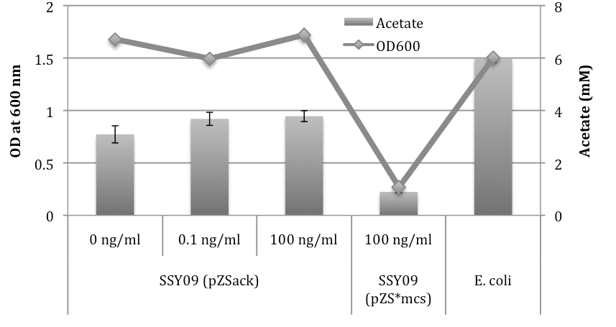
A. Improvement in cell growth upon basal level of ack expression
ACK (ackA)
Acetyl-phosphate
Acetate
ATP

Slide 22
Final strain SSY09-ACK, 300ml LB, 50g/l glucose/xylose, pH 7.2
Maximum Ethanol
Productivity= 12.34 mmol/l/h
Ethanol Yield = 0.483 g/g
Maximum Ethanol
Productivity= 1.67 mmol/l/h
Ethanol Yield = 0.233 g/g

Slide 23
B. pH and microaerobic condition optimisation
SSY09 pZS-ACK pH6.3 Microaerobic
(Glc + Xyl)
Maximum Ethanol
Productivity= 6.84 mmol/l/h
Ethanol Yield = 0.416 g/g
Maximum Ethanol
Productivity= 14.94 mmol/l/h
Ethanol Yield = 0.411 g/g

Slide 24
Still to Achieve:
Co-utilization of the sugars, hexose & pentose
Adaption in minimal media on Xylose
Engineering the microbe for the extra ATP for faster production rates
Fine tuning of the Ack expression

Slide 25
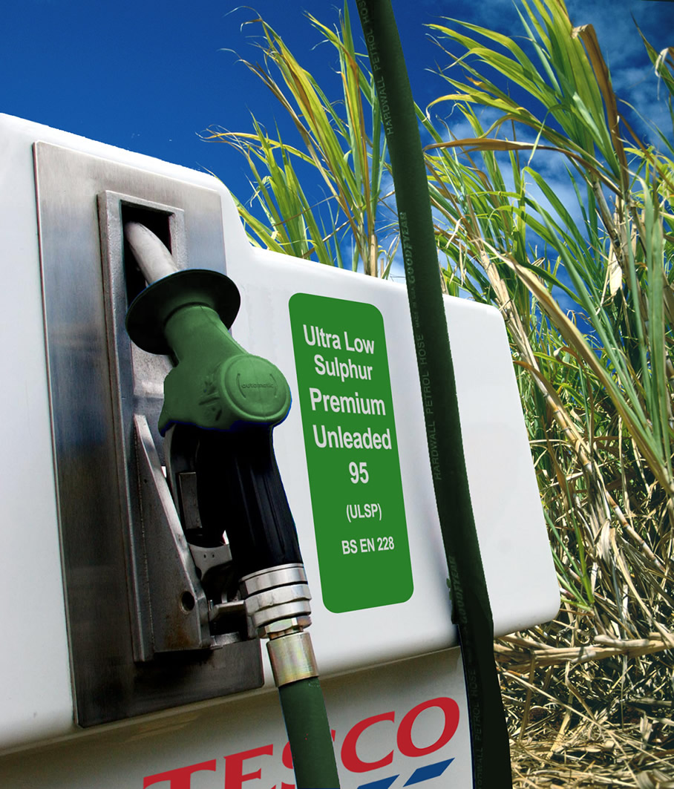
A BioEthanol pump
Very soon !!!
Thank you

