Slide 1
The regulation of cell-to-cell communication during pathogen attack
Christine Faulkner

Slide 2
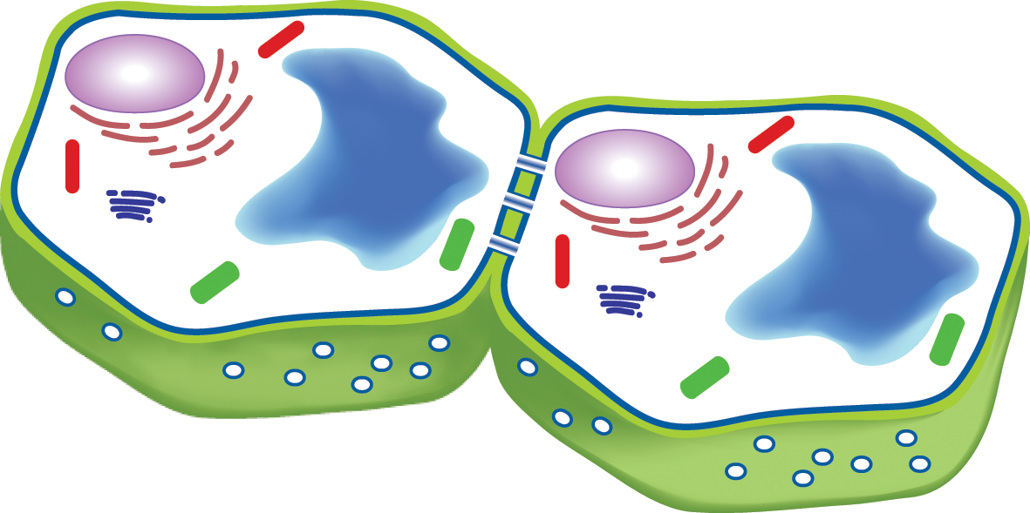
What role does cell-to-cell communication play in regulating defence responses?
X
X
X
Plasmodesmata-located pattern recognition receptor indicates that the regulation of connectivity between cells is a critical component of plant defence responses
A plasmodesmata-located receptor-like protein specifically localises to haustoria upon infection

Slide 3
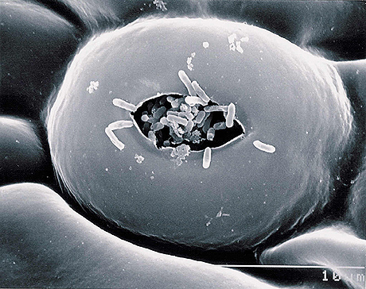
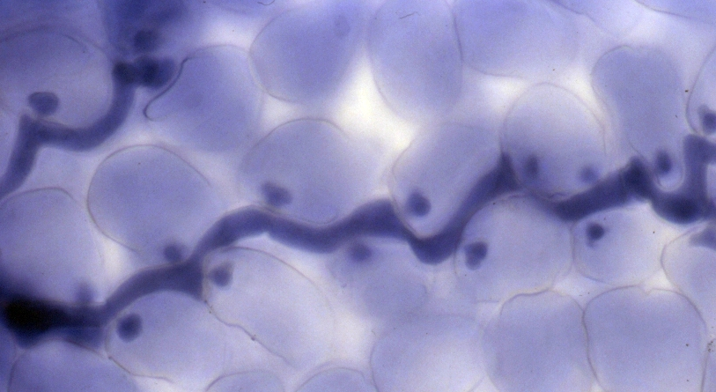
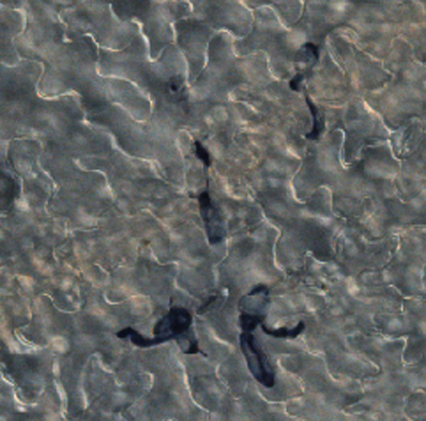
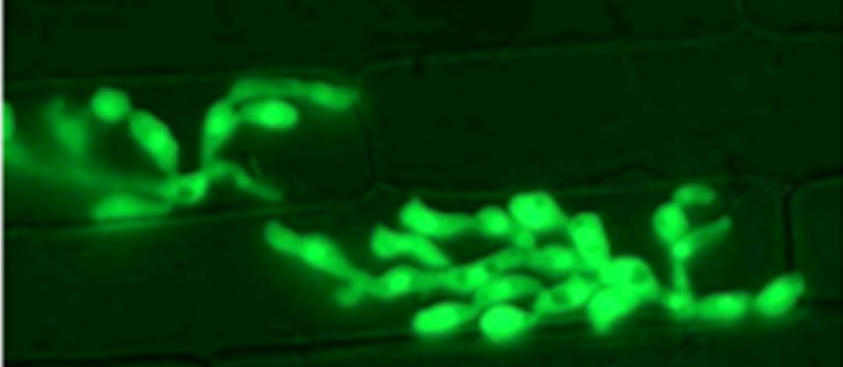
Pathogens exploit a variety of infection mechanisms
Notes:
Many plant pathogens are bacterial, fungal or oomycete species. They employ a wide variety of infection mechanisms
Entry – through stomata or direct penetration of an epidermal cell
Growth – extracellular or intracellular
We have gained a significant understanding of the nature of the interactions that occur when a pathogen attacks a plant but in many respects these have only highlighted the intricacies and complexities of these interactions and have failed to yet arm us with broad-spectrum strategies to enable plants to overcome economically devastating pathogens

Slide 4
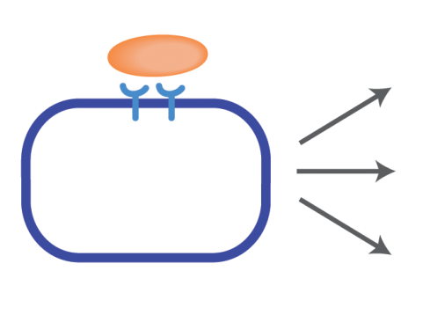
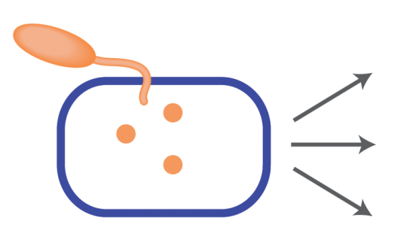
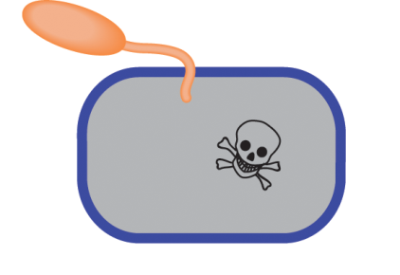
The zig-zag-zig model of plant-pathogen interactions
Jones and Dangl, 2006
PAMP-triggered responses
MAPK signalling cascades
[ROS]
Stomatal closure
Gene induction
Callose deposition
[Ca²⁺]
PAMPs
flagellin
chitin
INFECTION
Effector-triggered responses
Hypersensitive response – programmed cell death
RESISTANCE
Notes:
What we know of plant-pathogen interactions can be described as multi-layered attack and defence
When a plant cell perceives a pathogen in its environs, extracellular receptors detect pathogen-associated molecular patters (PAMPS). PAMPs include molecules such as flagellin and chitin, extracellular components of bacterial and fungal organisms respectively. These receptors, known as PRRs bind PAMPs and this triggers a host of non-specific, primary defence responses
If the pathogen can overcome these defences and invade the cell it introduces a number of its own proteins (effectors) into the cell. These effectors are pathogen-specific and perform a variety of functions. These effectors can suppress defence responses and if they successfully do so lead to the establishment of a successful infection. If, however, the plant is able to mount effector-triggered responses, many of which involve the activity of R-genes against specific effectors, it can exhibit resistance against the pathogen. Effector-triggered responses often lead to the hypersensitive response – programmed cell death of the attacked cell
When we consider these responses we look at a single cell, how the attacked cell is responding. It is established that systemic tissues can be primed for defence (systemic acquired resistance) which requires long-distance signalling. Plant cells are connected to their neighbours and in approaching defence repsonses as cell autonomous responses we are ignoring the fact that the cytoplasm of a cell is part of a much bigger entity –the symplast. We haven’t considered what happens to cells surrounding the infection site

Slide 5
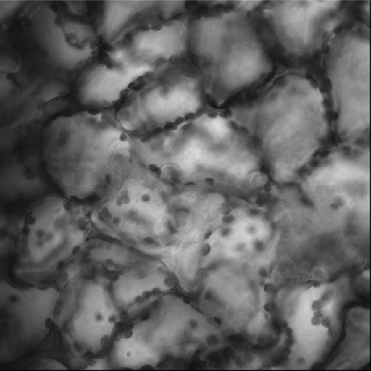
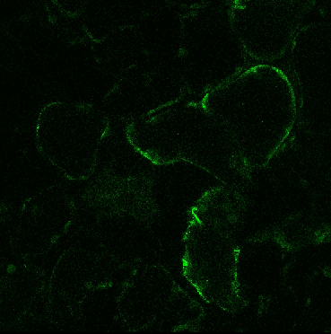
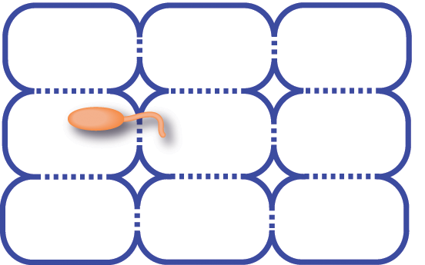
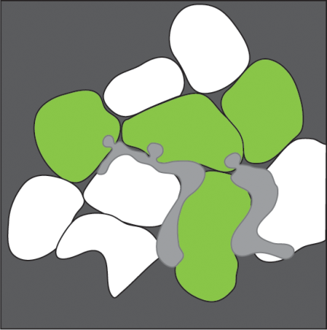
What communication occurs between cells during pathogen attack?
?
?
?
Do signals from the attacked cell send out a warning to surrounding cells?
Notes:
For example, does the attacked cell send out warning signals to neighbouring cells?
This image is of downy mildew infected tissue that expresses a promoter-GFP fusion. Mapping the activation of this promoter around infected cells shows that the promoter is activated in invaded cells and in some cells surrounding the invaded cells.
Is there a signal?

Slide 6
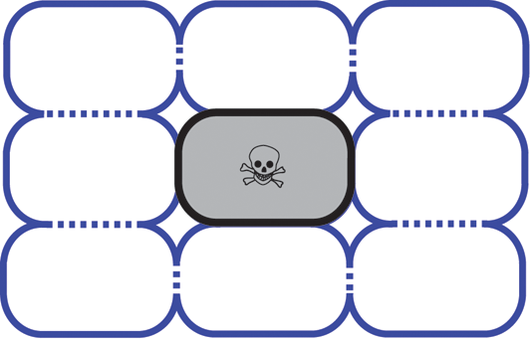
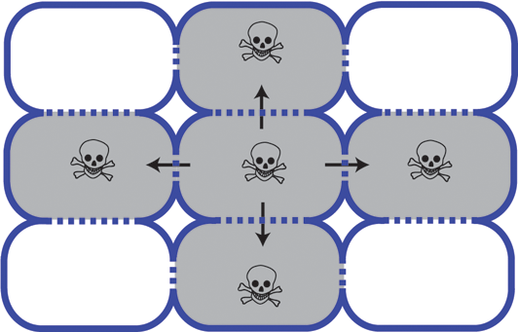
What communication occurs between cells during pathogen attack?
Spread of toxins/cell death
Cell-restricted cell death
Cell autonomy must be imposed prior to cell death
Notes:
Or if we consider that a cell under pathogen attack generates high concentrations of small, toxic molecules (calcium ions, NO, ROS). These molecules are small enough to simply diffuse between cells and therefore the question must be asked why don’t we see a spread fo their effects? We see cell-restricted cell death and therefore, a mechanism is required by which cell-autonomy of the attacked cell is imposed prior to cell death.

Slide 7
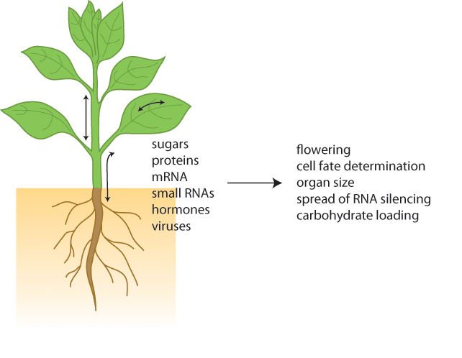
Cell-to-cell communication is fundamental to developmental processes
What role does cell-to-cell communication play in defence responses?
Notes:
Many classes of molecules are known to move within and between plant tissues and organs. In addition to small metabolites many classes of molecules have been found to move via both active and passive mechanisms between cells and tissues. This is fundamental for many developmental processes. In some cases changes to the movement of molceules is twinned with changes to symplastic connectivity (how connected the cells are to their neighbours) and these are often tarnsient and reversible changes.

Slide 8
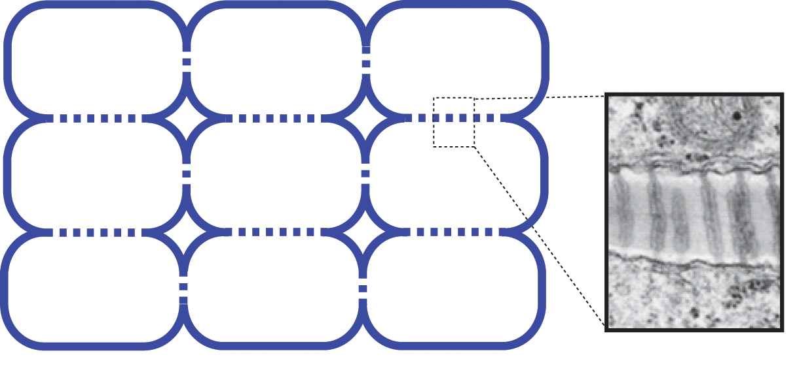
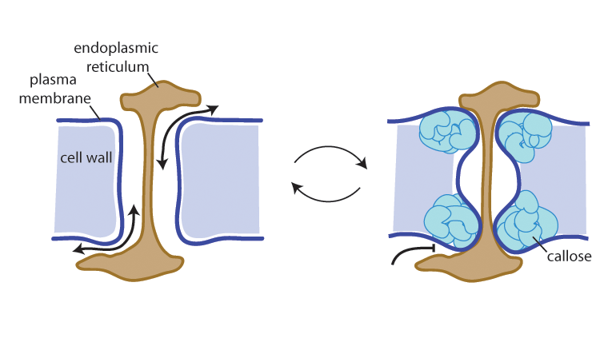
Plasmodesmata allow symplastic continuity and cell-to-cell communication
200nm
Plasmodesmata are dynamic – they open and close reversibly to generate domains of communication
Notes:
Most plant cells are connected to their neighbours via channels called plasmodesmata. Through these channels that molecules move. Plasmodesmata are pores that are line by the pm from neighbouring cells and cross the cell wall, creating continuity between the cytoplasms of neighbour cells. The ER is also continuous between cells creating an addition communication pathway.
Whether or not plasmodesmata are open or closed are key to developmental processes such as cotton fibre cell elongation and the transition to flowering and so PD function is a logical place to start in identifying the regulation of cell-to-cell communication during pathogen attack

Slide 9
Plasmodesmatal Structure and Function
LYM2 GPI anchored LysM domain protein
PDLRK LRR receptor-like kinase
ARK3 S-domain receptor-like kinase
Notes:
PD structure and function is extremely poorly defined. Due to the difficulty of extraction membrane rich structures that are embedded in the cell wall. However, we recently made advances in PD purification and were able to identify 1341 proteins that were present in extracts from purifed PD.
In looking for defence candidates I focussed on membrane proteins and identified 5 candidates

Slide 10
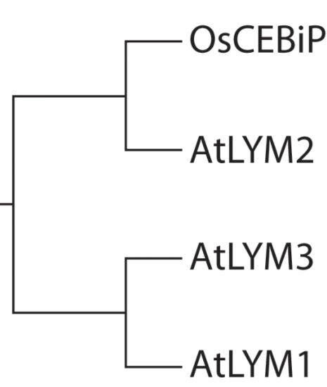
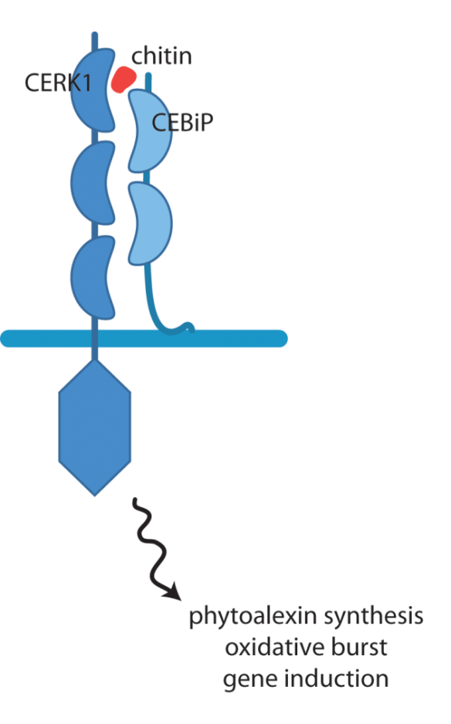
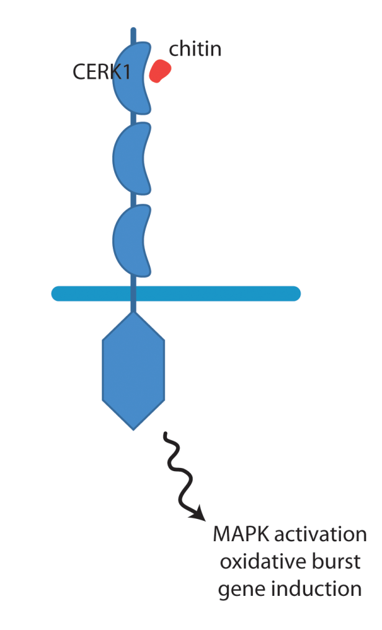
LYM2 is a plasmodesmata-located chitin receptor
RICE
ARABIDOPSIS
LYM1-mCitrine
LYM2-mCitrine
LYM3-mCitrine
Notes:
LYM2 is a homologue of CEBiP which was first chitin receptor identified. LYM2 and CEBiP are RLPs, GPI anchored proteins with 2 extracellular LysM domains. They don’t fit the classical model of a Pattern recognition receptor in that they have no intracellular domain to trigger intracellular chitin-triggered defence responses and thus it is not surprising that chitin perception in rice required complex formation with the receptor-like kinase CERK1.
In Arabidopsis it has been shown that for the measured chitin-triggered defence responses CERK1 alone is required. Which raises the question – what do the LYM family proteins do in Arabidopsis?
We examined the subcellular localisation of the LYM protein family in Arabidopsis and you can see that while all 3 are localise to the cell periphery, LYM1 and 3 have a different localisation pattern to LYM2. This punctate pattern looks like PD localisation

Slide 11
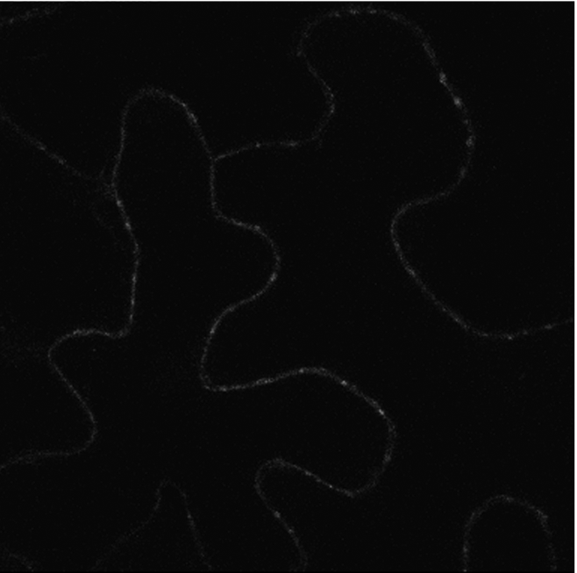
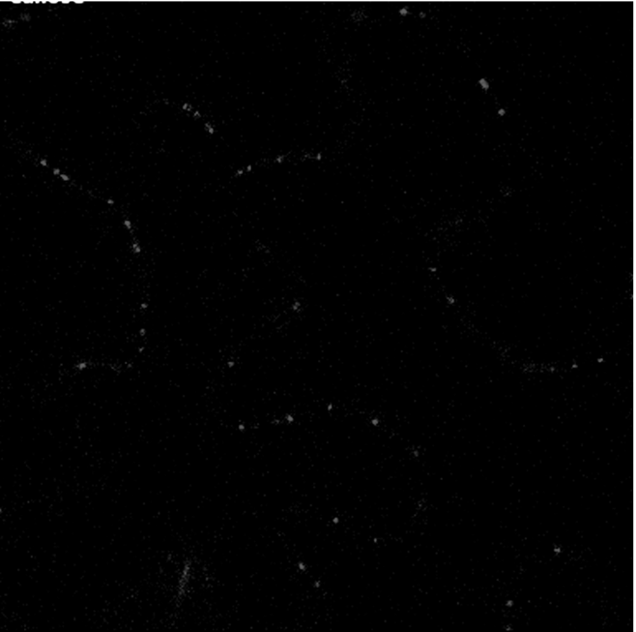
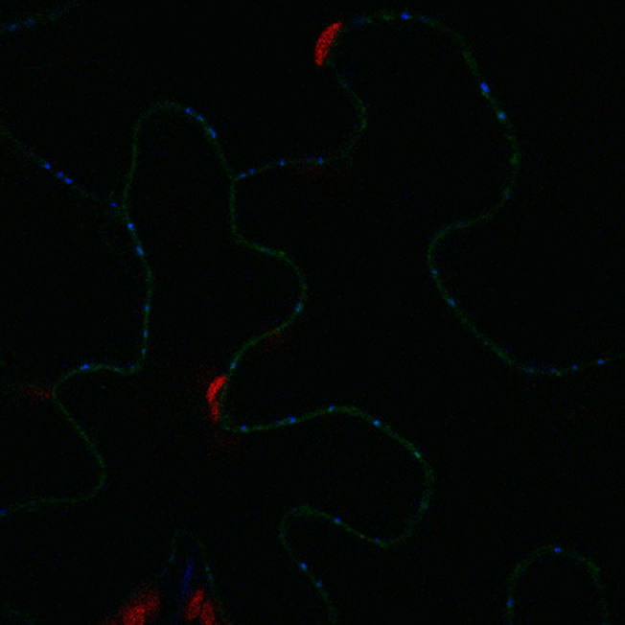
LYM2 is a plasmodesmata-located chitin receptor
LYM1-mCitrine
LYM2-mCitrine
LYM3-mCitrine
LYM2-mCitrine
Aniline blue
overlay
Notes:
To confirm PD localisation we examined co-localisation with aniline blue staining of callose which is deposited at PD. As you can see by co-loc LYM2 is located at PD
Which hints that it may have a role in PD function

Slide 12
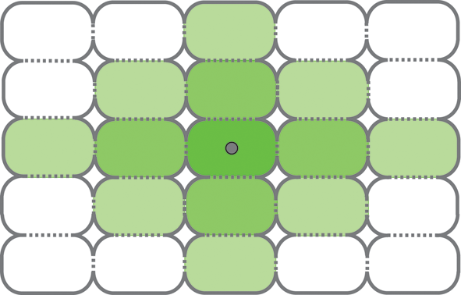
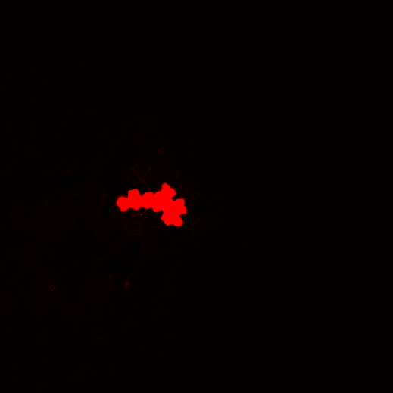
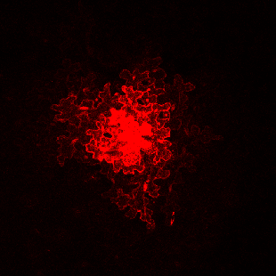
Microprojectile bombardment assay for plasmodesmal function
Microprojectile bombardment
35S mRFP
Measure of:
passive transport
cell-to-cell connectivity
Notes:
PD function and cell-to-cell connectivity can be measured by the introduction of a fluorescent probe to a single cell and monitoring spread of the probe. For this I use microprojectile bombardment of a vector that expresses cytosolic mRFP. The gene is coated on gold particles and bombarded into leaf tissue. The gene is expresses in the transformed cell and the protein diffuses from the site of expression. Count the cells as a measure of connectivity

Slide 13
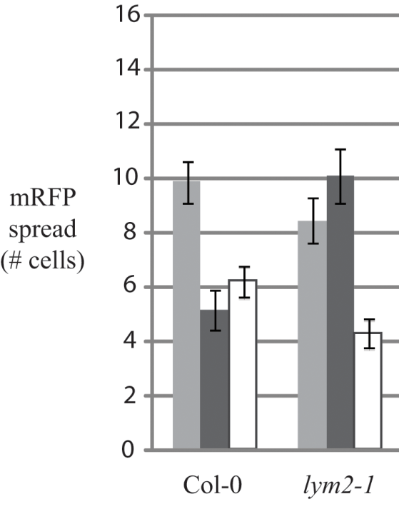
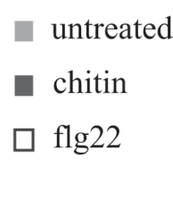
PAMPs cause plasmodesmal closure
Chitin-triggered closure of plasmodesmata requires LYM2
-PAMP
+PAMP
Notes:
Used this assay to determine what effect different PAMPs have on cell-to-cell connectivity of Arabidopsis leaves. In wild-type Col-0 leaves Both chitin and flg22 (flagellin derivative) cause a decrease in the flux of mRFP from the bombardment site, indicative of a reduction in cell-to-cell connectivity or increased PD closure.
In lym2 mutant lines, this effect was seen in the presence of flg22, but was absent in the presence of chitin
Suggesting that LYM2 has a specific function in the regulation of molecular flux in the presence of chitin

Slide 14
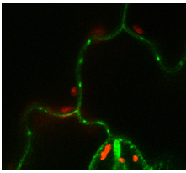
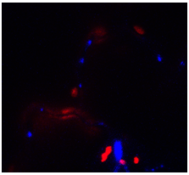
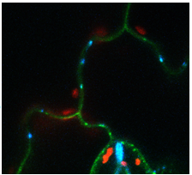
FLS2 mediates flg22-induced plasmodesmal closure
FLS2 is the flagellin receptor in Arabidopsis
FLS2-GFP
*
***
**
FLS2-GFP
aniline blue
overlay

Slide 15
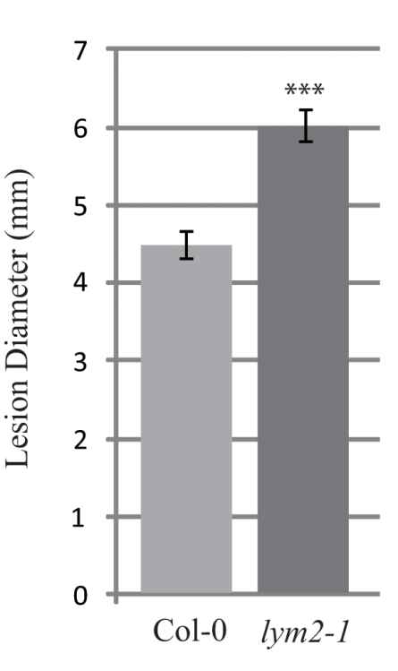
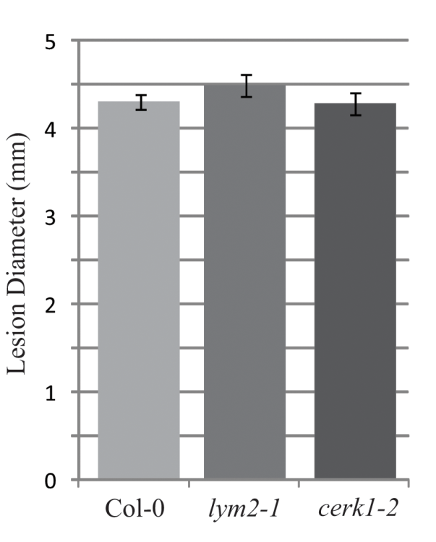
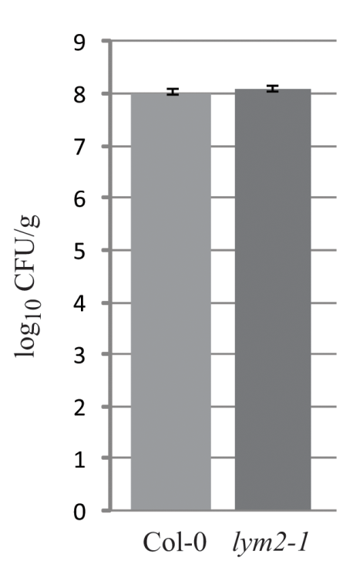
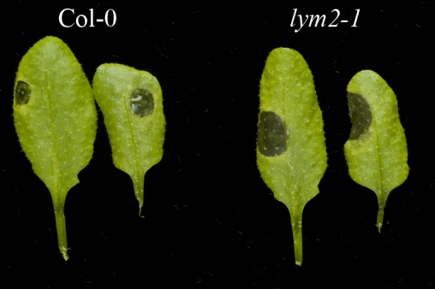
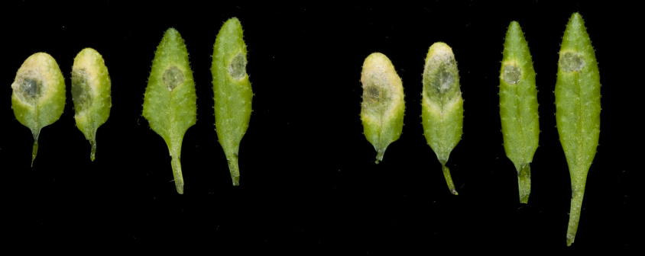
PAMP-triggered plasmodesmata closure is a component of defence responses
Botrytis cinerea
fungal pathogen
contains chitin
Colletotrichum higginsianum
fungal pathogen
contains chitin
Pseudomonas syringae
bacterial pathogen
does not contain chitin
BUT C. higginsianum has LysM effectors that mask the detection of chitin
Col-0
lym2-1
Notes:
How does this relate to pathogen attack? We were also able to show that LYM2 contributes to defence against a fungal pathogen
Botrytis is a fungal pathogen and so contains chitin. Lesion size was much larger in lym2 mutants, and smaller in LYM2 overexpressors
This difference was not observed for a bacterial pathogen, Illustrating the specificity of LYM2 activity to chitin
This data alos demonstrates that changes to cell-to-cell connectivity are a significant contributor to defence responses

Slide 16
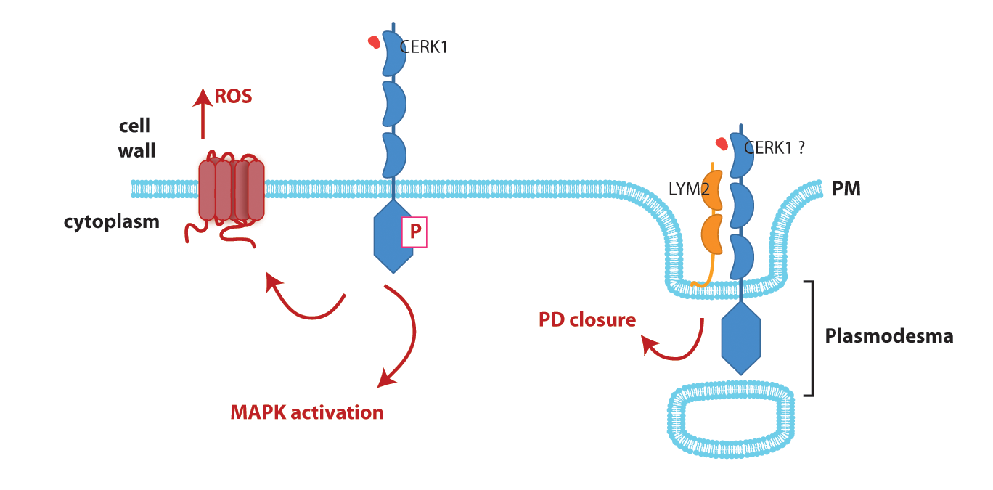
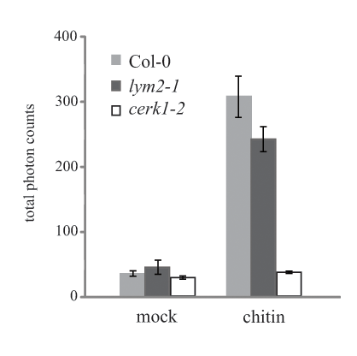
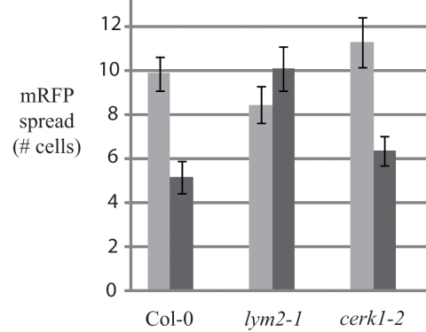
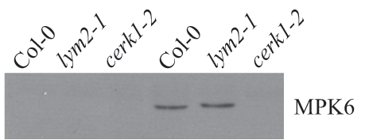
Testing the rice model for chitin perception
LYM2 can bind chitin
LYM2 is not required for CERK1 chitin binding
LYM2 binds chitin (Petutschnig et al., 2010)
α−CERK1
- +
- +
Notes:
Given the observation that CEBip is a chitin receptor and LYM2 is required for chitin-triggered closure of plasmodesmata, how does chitin perception by CERK1 relate to LYM2 acitivity?
Is LYM2 a chitin receptor? LYM2 binds to chitin-binding beads
LYM2 is not required for CERK1 binding of chitin
LYM2 is not required for chitin-triggered CERK1 phosphorylation, ROS burst or MAPK activation
CERK1 is not required for chitin-triggered closure of PD

Slide 17
CERK1 and LYM2 mediate independent chitin perception pathways
LYM2 is not required for CERK1-mediated responses
CERK1 is not required for LYM2-mediated responses
X
Notes:
CERK1 and LYM2 function in independent chitin-perception pathways

Slide 18
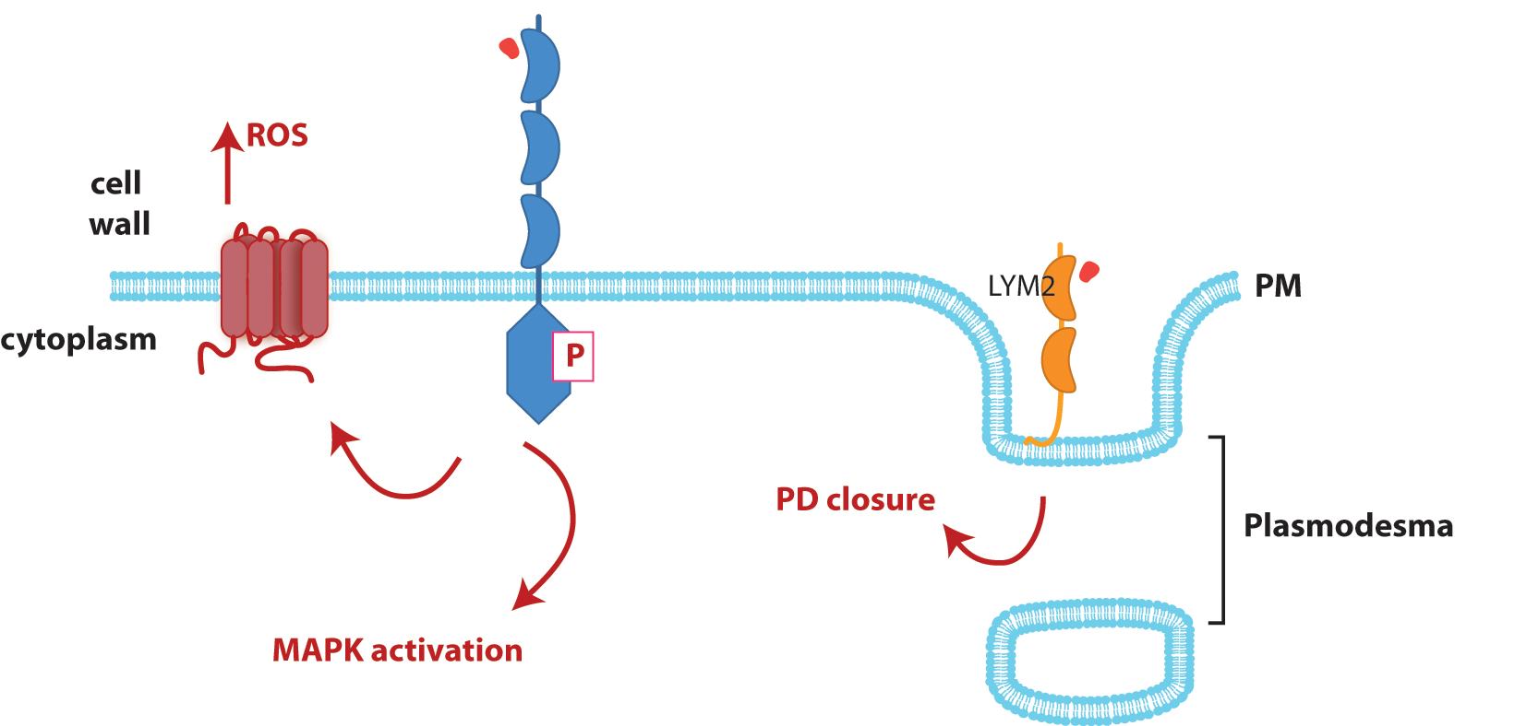
Defence responses with discrete subcellular locations
LYM2 is a pattern recognition receptor with a specific location and function
CERK1
Notes:
Not only are these chitin-triggered pathways independent but they are also spatially separated, raising the concept of localised defence repsonses within a cell

Slide 19
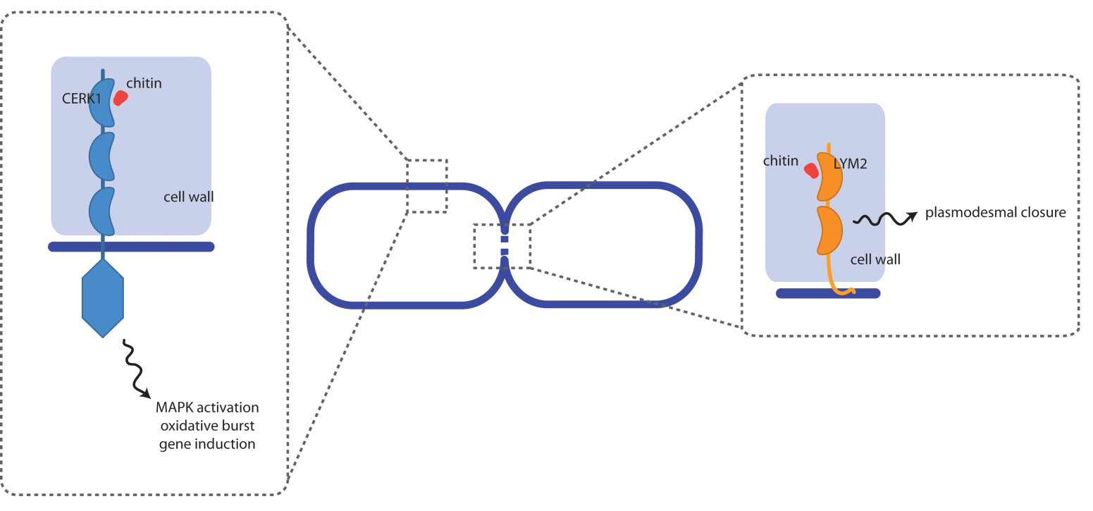
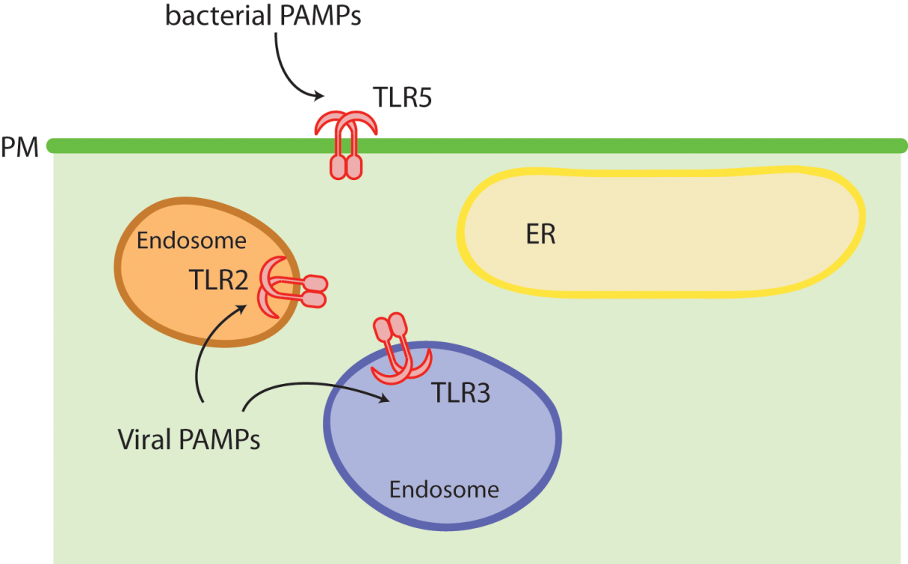
Defence responses with discrete subcellular locations
PRRs may be localised for detection or signalling activity
In animal cells Toll-like receptors (TLRs) are localised in different locations to detect different PAMPs
modified from Kawai and Akira, 2011
Notes:
This is a concept that is well established in animal systems. Toll-like receptors function in host-cell recognition and the perception of a wide variety of PAMPs.
TLR1, 2, 4, 5, 6 localise to PM and recognise microbial membranes
TLR3, 7, 8 and 9 localise to intracellular vesicles and recognise nucleic acids
Location separation for detection AND downstream signalling

Slide 20
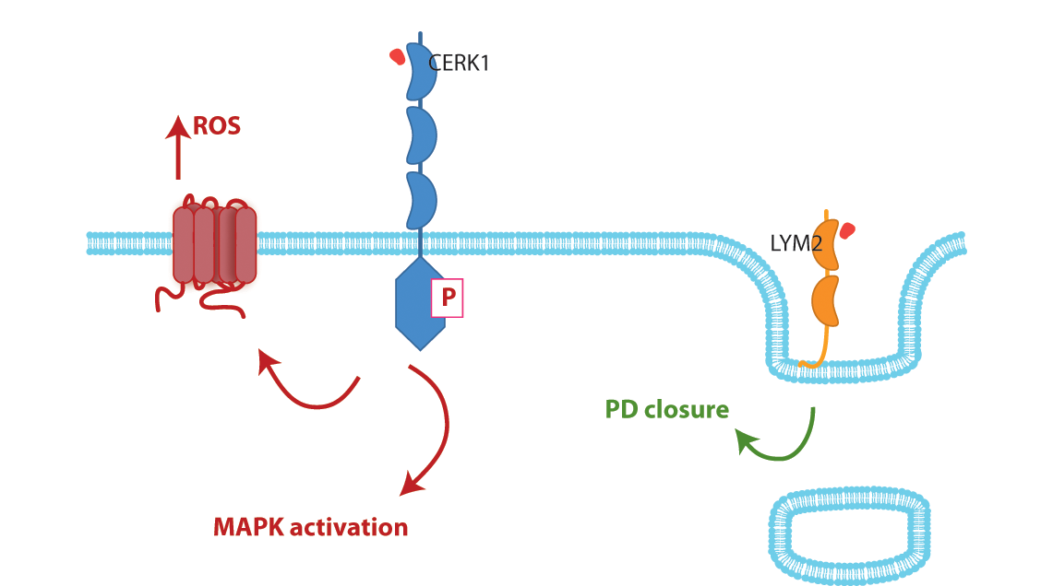
How can I dissect symplastic regulation during pathogen attack?
What is the mechanism by which LYM2 closes PD?
?
?
What are the interacting proteins and components of the signalling pathway?
How do plasmodesmata close in the presence of chitin? Is this a callose based mechanism?
Pathogen attack provides a conditional context in which to dissect plasmodesmata function
a novel facet of defence responses
mechanics of plasmodesmal function
Notes:
Long term goal of my research is to characterise the role cell-to-cell communication plays in defence responses and how this can contribute to pathogen resistance
Address a number of short-term goals
There are a number of questions raised by the identification of a PD-specific chitin-perception mechanism
What is the signalling pathway? How does LYM2 act?
How do PD close?
We know that in developmental contexts PD closure is controlled by specific callose deposition at the pore itself. Does this occur during chitin perception?

Slide 21
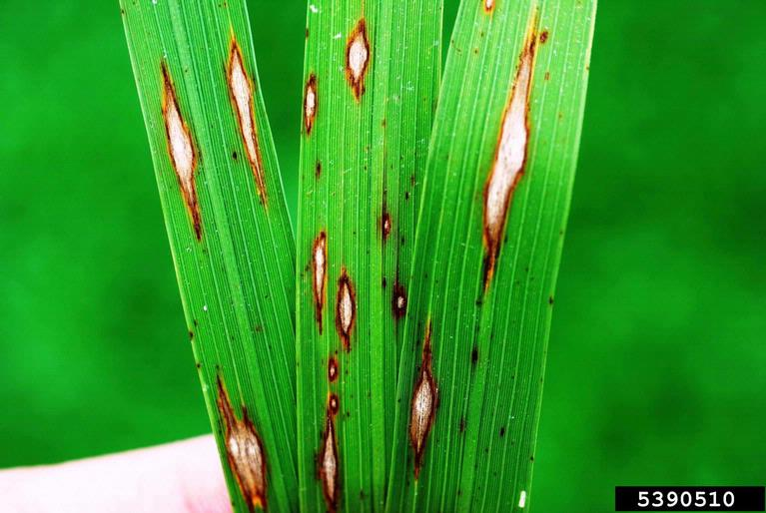
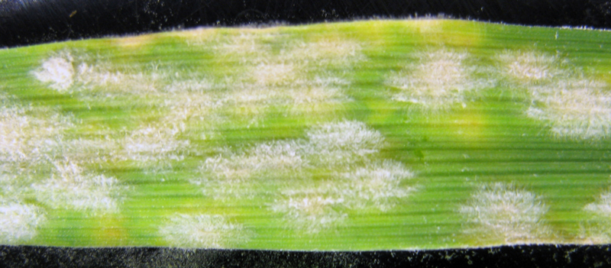
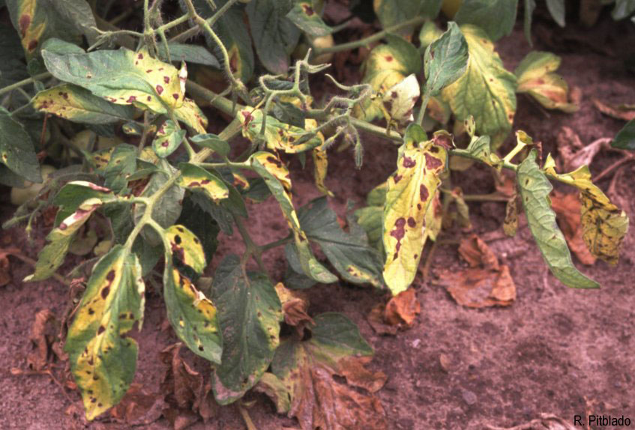
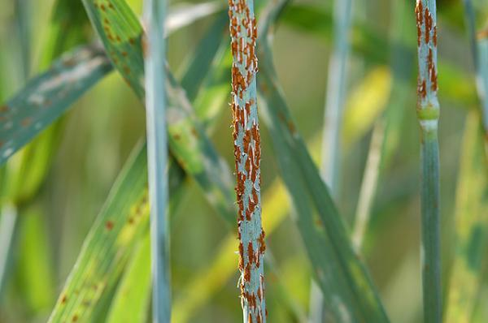
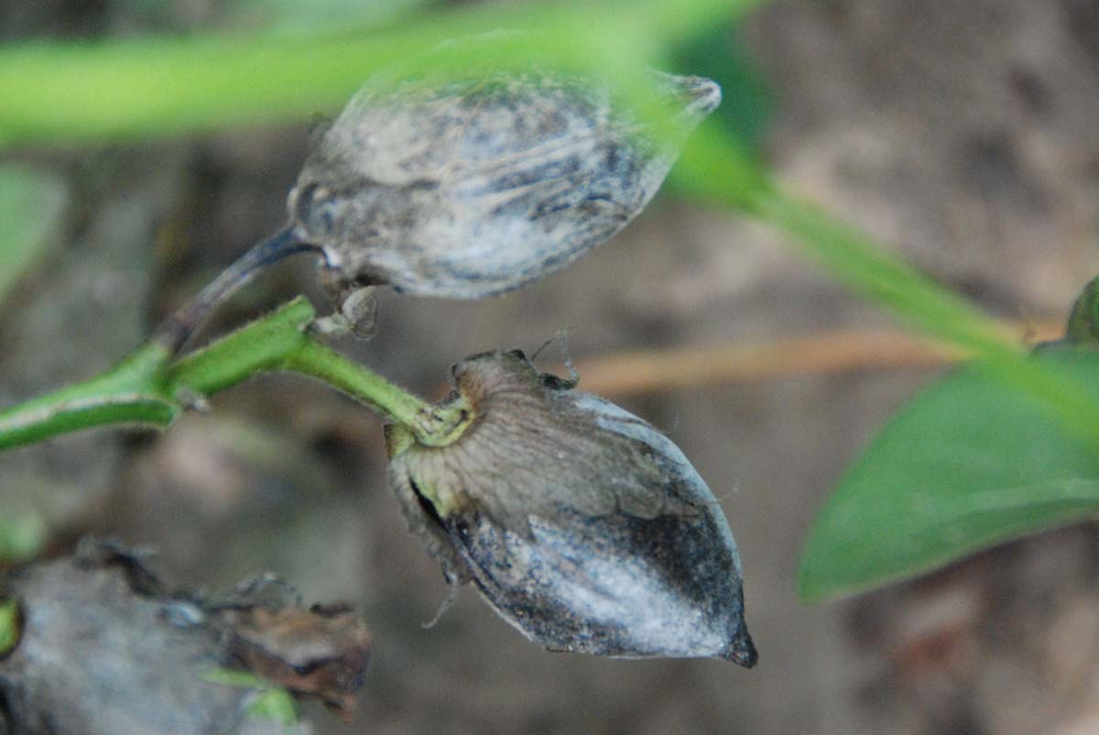
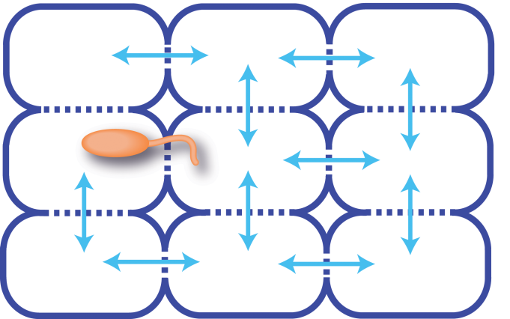
Cell biology of plant-pathogen interactions
Novel facet of defence responses
Cell biological perspective on the mechanisms of pathogen attack
Direct pathway for application to crop species
Notes:
As a research area, the regulation of cell-to-cell communication, PD function and localised signalling during plant-pathogen interactions falls within the Plant Perception and Response to the Envrionment ISP. In identifying and unlocking a novel facet of plant defence repsonses this research will providea fundamental aspect of future efforts to fully understand and manipulate pllant disease resistance.

Slide 22
PAMP-triggered plasmodesmal closure in rice?
How does PAMP-triggered response contribute to defence responses employed by crop species?
LYM1, 2, 3
OsCEBiP, OsLYM1a, 1b, 3, 4
Arabidopsis
Rice
HvCEBiP, others?
4 LYM proteins
Barley
Brachypodium
Notes:
This project also carries the potential for swift application to crop species.
Initially, we need to map how molecular flux changes during pathogen attack in crop species. Primarily in rice and barley
Given that the rice LYM family proteins have been identified but only CEBiP has been functionally characterised it is possible that the closest LYM2 homologue OsLYM4 also functions in the regulation cell-to-cell communication
The rice blast pathogen Magnaporthe exploits PD to get from cell-to-cell and introduces an effector that moves from infected to non-infected cells ahead of the invasion hyphae. Therefore, it will be particularly interesting to exmaine the regulation of cell-to-cell communication and PD function during this host-pathogen interaction.
Barley CEBiP has also been identified allowing for dissection of its function. Chris Ridout’s group is already performing experiments to determine whether it can complement the lym2 mutant

Slide 23
The role of plasmodesmata in Magnaporthe invasion
Invasion hyphae cross between cells at PD
Kankanala et al., 2007
Effectors can be non-cell autonomous
PWL2:mCherry:NLS + BAS4:eGFP
Khang et al., 2010

Slide 24
The role of plasmodesmata in Magnaporthe invasion
Does chitin-triggered PD closure occur in rice?
How does this affect Magnaporthe invasion?
does plasmodesmal closure restrict invasion hyphae from spreading cell-to-cell?
can this be manipulate to enhance defence?

Slide 25
Cell biology of plant-pathogen interactions
Notes:
As a research area, the regulation of cell-to-cell communication, PD function and localised signalling during plant-pathogen interactions falls within the Plant Perception and Response to the Envrionment ISP. In identifying and unlocking a novel facet of plant defence repsonses this research will providea fundamental aspect of future efforts to fully understand and manipulate pllant disease resistance.

Slide 26
Pathogens exploit a variety of infection mechanisms
Faulkner and Robatzek, COPB, 2012
Notes:
As I mentioned before pathogens exploit a number of invasion strategies, all stay extracellular.
Particularly interested in haustroial formation (fungal and oomycete)

Slide 27
Downy mildew forms haustoria in mesophyll cells to access host nutrients
encasement
extra-haustorial
membrane
Notes:
Downy milddew – oomycete
Forms haustoria
Progressively encased (4d unencased, 7 day encased) EHM

Slide 28
The plasmodesmal protein PDLP1 specifically localises to the haustorial membrane
PDLP1-GFP
remorin-GFP
MP17-GFP
Notes:
PDLP1 is a PD protein of unknown function
Intriguingly localises to haustoria upon infection
Not all pd proteins relocalise

Slide 29
The extra haustorial membrane (EHM) is differentiated from the plasma membrane
SWEET1-YFP
EHM
SWEET3-YFP
PEN1-GFP
PDCB1-mCherry
Notes:
The membrane (EHM) around the haustoria is continuous with the plasma membrane but seems to be specialised eg. SWEET proteins specifically target
Most PM proteins target to developing encasement

Slide 30
PDLP1 is
PDLPs are PD-located proteins with no known function
PDLPs have some redundancy of function

Slide 31
The PDLP1 gene is turned on in haustoria – containing cells
pro(PDLP1)::GUS
pro(PDLP2)::GUS
*
*
*
*
pro(PDLP3)::GUS
pro(PDLP5)::GUS
*
*
*
Notes:
Is PDLP1 localisation at haustoria biologically relevant?
Yes – promoter fusions

Slide 32
PDLP1 expression affects infection success of downy mildew
Notes:
Overexpression and triple knockouts show increased resistance and susceptibility

Slide 33
PDLP1 localisation at haustoria is dependent upon the transmembrane domain
PDLP1-GFP
SP-mcitrine-TM(+cyt)
AT5G41300-mcitrin
*
*
*
*
*
*
*
10 μm
The PDLP1 transmembrane domain is sufficient to target a
fluorescent protein to plasmodesmata and to haustoria
Notes:
Similar to tragetting toPD

Slide 34
PDLP1 regulates callose encasement of haustoria
Notes:
One similarity between PD and haustoria is deposition of callose

Slide 35
How does a plasmodesmal protein end up at haustoria?
Notes:
model

Slide 36
How does a plasmodesmal protein end up at haustoria?
Pull down assays with PDLP1-GFP identified patellin1, which localises to the cell plate
Aniline blue
PDLP1-GFP
Does haustoria formation mimic cell plate formation?

Slide 37
Future directions
What is the mechanism by which LYM2 closes PD in the presence of chitin?
Why do cells become symplastically isolated following pathogen detection?
How can plant defence be enhanced by symplastic isolation?
What proteins close PD in the presence of flg22? Is there an equivalent Ax21 response?
How does PDLP1 regulate callose deposition at plasmodesmata and haustoria?
Does haustorial formation mimic cell plate formation?
Can we model the spread of defence –associated signals to predict response?
How can we exploit this defence mechanism to enhance defence?

Slide 38
Acknowledgements
Yoselin Benitez-Alfonso
Andy Maule
Lourdes Fernandez-Calvino
John Walshaw
Georg-August-Universität Göttingen
Volker Lipka
Elena Petutschnig
Silke Robatzek
Martina Beck
Ji Zhou
Heidrun Haweker
Cyril Zipfel
Freddy Boutrot
Cécile Segonzac
Henk-jan Schoonbeek
Yang Zhang
Chris Ridout
Marie-Cécile Caillaud
Lennart Wirthmuller
Sophie Piquerez
Jonathan Jones

Slide 39
Notes:
Pathogens affect a wide variety of plants causing a wide variety of diseases
Wilts, blasts, rusts, mildews, rots, cankers…
All ultimately cause loss of yield - in an era in which food security is threatened and climate change carries the potential to change the ‘rules of the game’ when it comes to plant-pathogen interactions it is vital that we come up with answers and strategies to enable plants to overcome these pathogens

